Slide 1
Credit Limit Conditions
April 30, 2026

Slide 2
Credit Limit
Credit limit is a special commercial condition that allows our partners to make bookings without immediate payment and pay for bookings after the free cancellation deadline within the negotiated period of time.
Hotels
Air Tickets
Transfers

Slide 3
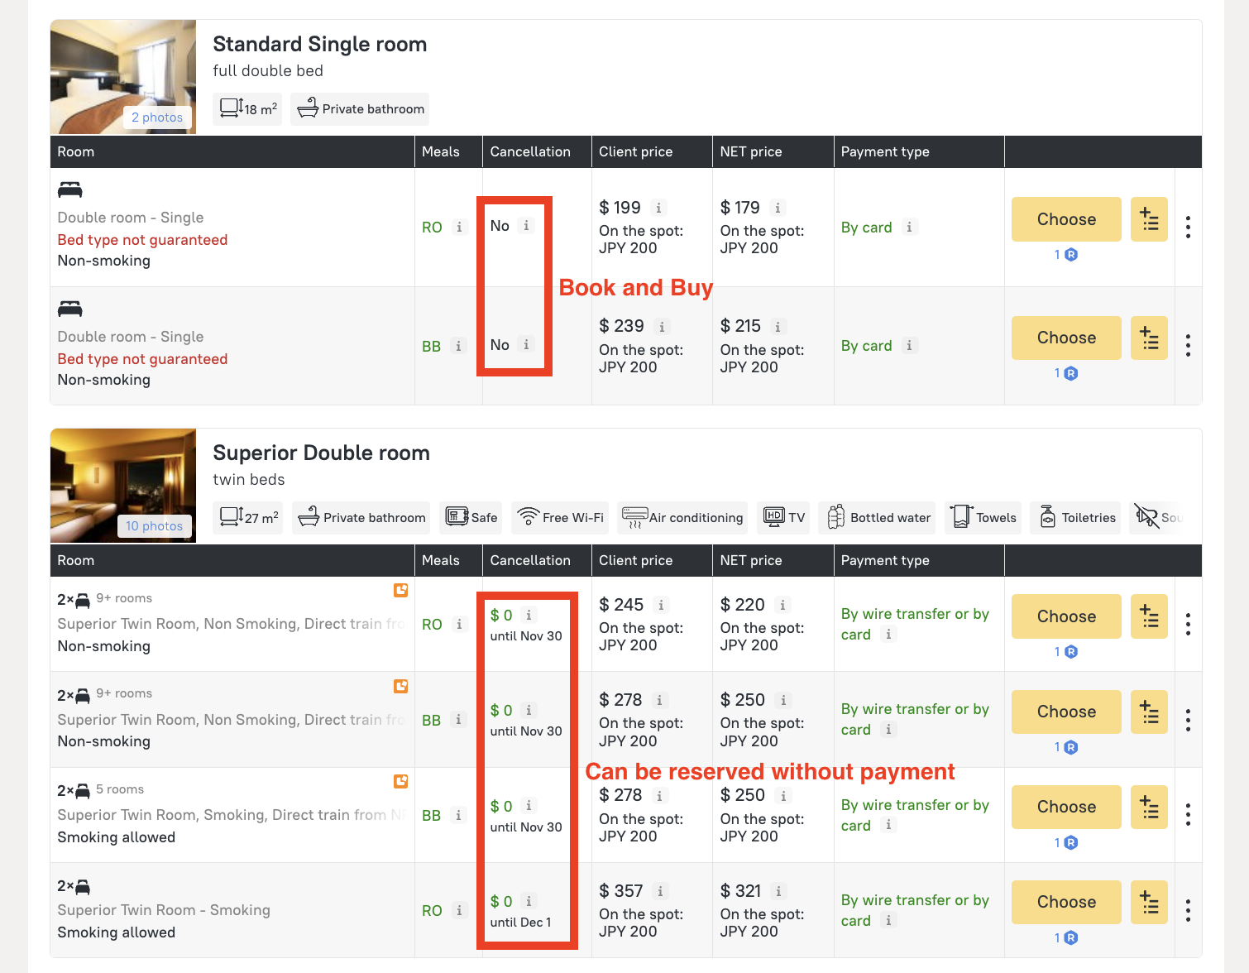
Only non-refundable bookings require credit limit to be made without an immediate payment

Slide 4
Refundable bookings do not require credit limit to be made.
Refundable bookings would only require to have a sufficient amount of credit limit to be secured at the time of free cancellation deadline, otherwise automatic booking cancellation may happen.

Slide 5
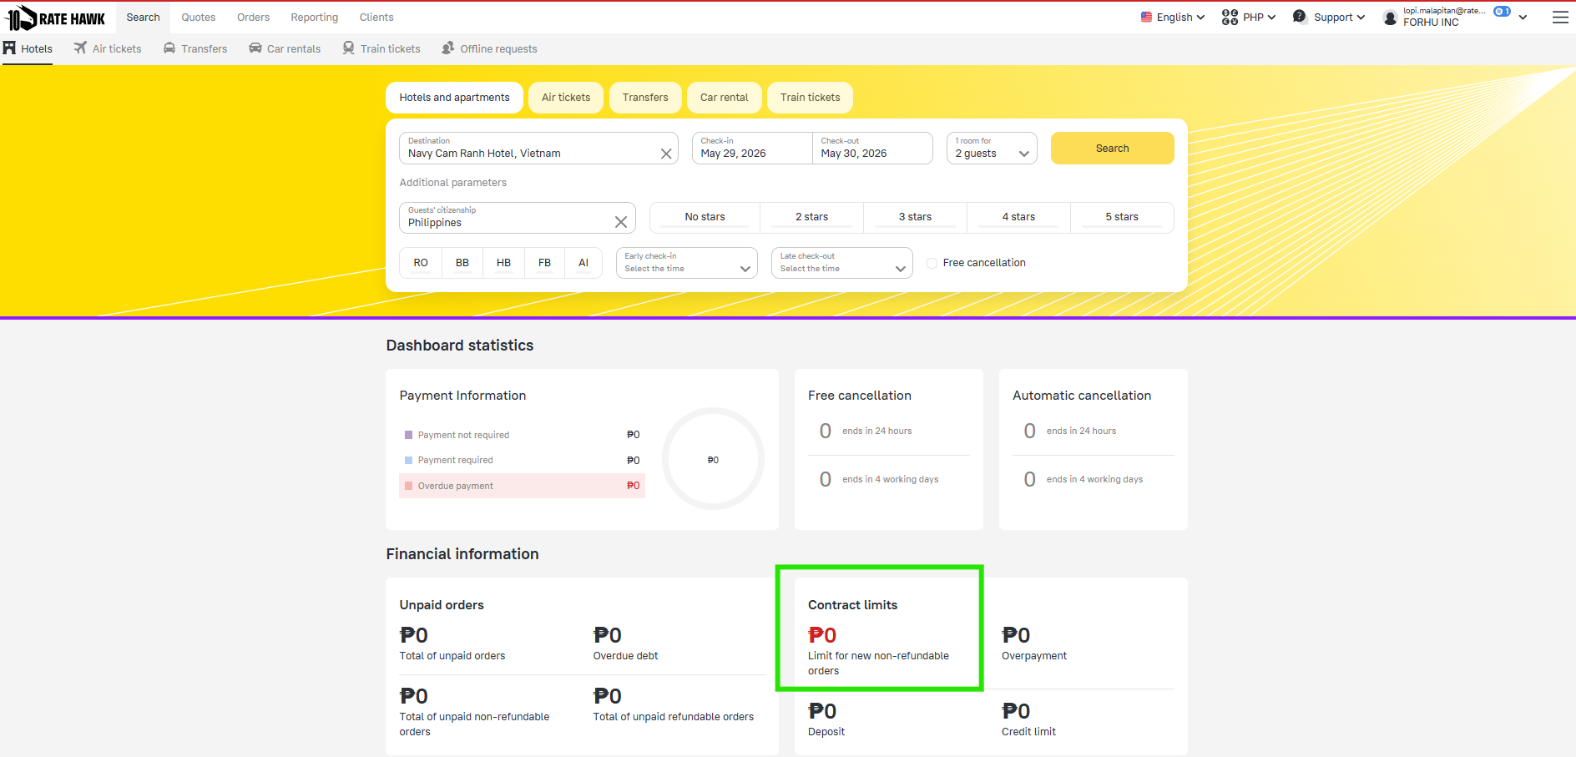

Slide 6
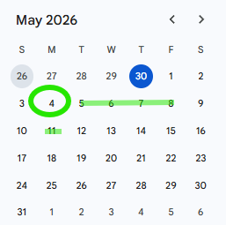
Payment Terms
For Bookings with check-in dates from the 1st through to the last day of a reporting month, Emerging shall submit to Partner a Transaction Statement and Invoice no later than the 3rd day of the month following the reporting month. Partner shall settle the Invoice within 5 working days upon receipt of the Invoice.
Example
Check-out Date : Apr 1, 2026
Invoicing Date : May 4, 2026
Payment Due : May 11, 2026

Slide 7
